Slide 1

Made possible by grants from the NSF and the Schmidt Foundation
PEARC21
OSN Pod Hardware & Software
July 19, 2021
NSF grants
1747552
1747493
1747507
1747490
1747483

Slide 2

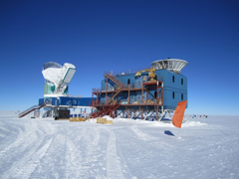


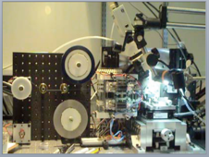


The Data Deluge
Capture | Store | Share | Analyze

Slide 3
US Research Cyber-Infrastructure Today
Local, Regional and National Resources
Standardized
Computation
Networking
Over 200 universities with 40/100Gb Connectivity
Standardized
Largely Balkanized
Many Standards to Choose From
Storage

Slide 4
The Open Storage Network
National resource for sharing open scientific data
Distributed Infrastructure and Governance
Notes:
Implementors, please stand up so we can see you!

Slide 5
The Open Storage Network
National resource for sharing open scientific data
Distributed Infrastructure and Governance
Notes:
Implementors, please stand up so we can see you!

Slide 6

Topics
OSN Pod Hardware and Software Design
OSN Command Center
How to Join the OSN

Slide 7
OSN Pod Hardware

Slide 8
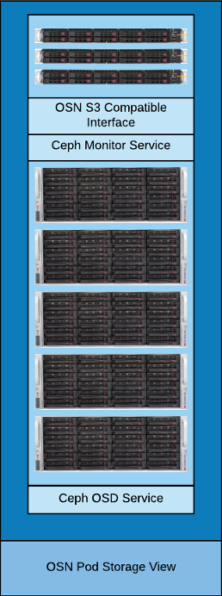
OSN Pod Overview
Hardware is deployed in “Scalable Units” known as Pods
Each Pod is:
A single bill of materials
Delivered with all hardware racked and configured
Sites just need to connect power and networking
Capable of 40Gbps sequential IO
Target cost $150,000
1 PB useable storage (\w 2019 hard drive prices)
Notes:
The single bill of materials will include everything needed to run an OSN pod.
The $150,000 cost is just a target because each state has different tax requirements and may need to work with specific VARs.

Slide 9
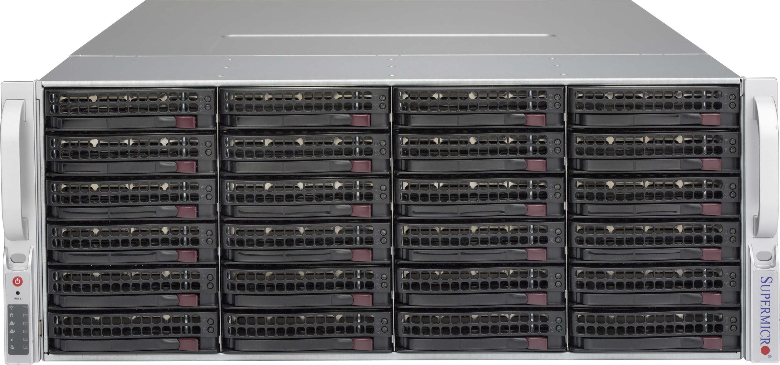
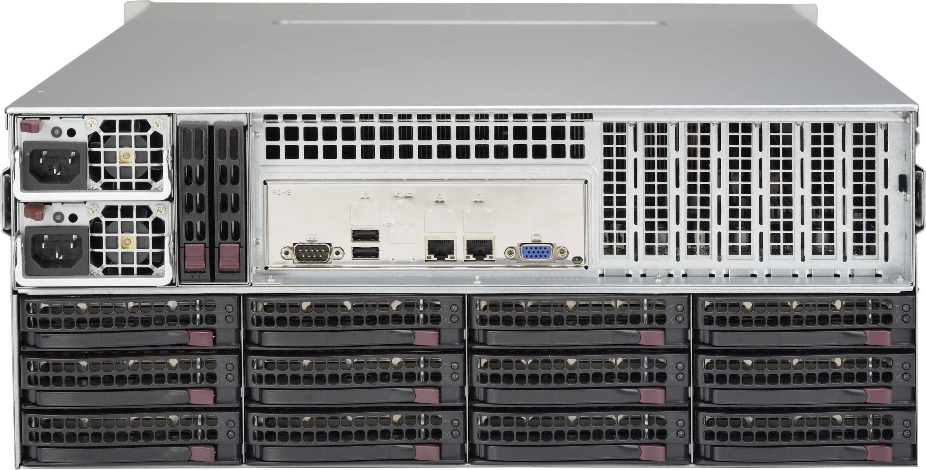
Storage Node Highlights
5 Storage Nodes per Pod
4U Supermicro Server
18 Core Skylake CPU
256 GB RAM
36 x 8TB Seagate HDD
2 x 50 GbE data network
5 Node Total: 1.44 PB Raw Storage
Complete Hardware Details at https://www.openstoragenetwork.org

Slide 10
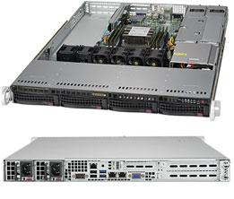
Proxy Node & Switch Highlights
3 Monitor/Proxy Nodes per Pod
1U Supermicro Server
18 Core Skylake CPU
256 GB RAM
2 x 50 GbE data network
Top of Rack Switches
Mellanox SN2100 16-port 100 GbE
Netgear M4300 24-port 1 GbE

Slide 11
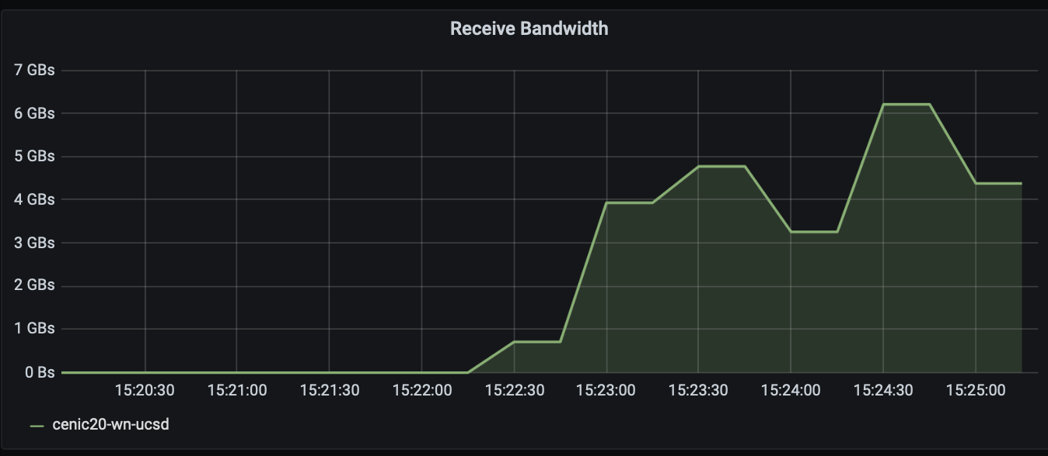
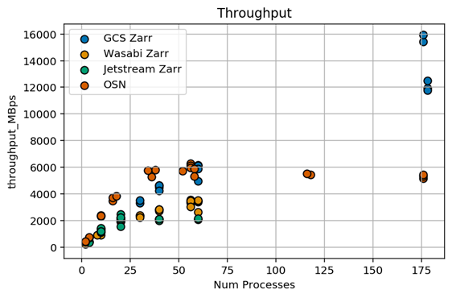
OSN Pod Benchmarks
IceCube (SDSC) recorded 5.5 GBps read speed from 10 nodes. IceCube only able to get 4 GBps from Azure Storage and AWS S3 in similar tests.
Pangeo (NCSA) was “extremely impressed” with the results of their benchmarks. Pangeo achieved 5.5 GBps read speeds from threaded tests. They reported higher throughput from the OSN than from Google’s Cloud Storage US-CENTRAL region. “OSN is a very viable alternative to cloud storage for us for many use cases” - Pangeo
Notes:
IceCube - The IceCube Neutrino Observatory - https://icecube.wisc.edu
Pangio - A community platform for Big Data geoscience - https://pangeo.io

Slide 12

Possible OSN Pod Updates for 2022+
High Redundancy Full Rack Pod:
12 Nodes
2U Servers
SSD/NVMe for Cache/Journal
Same rack, power, and networking requirements
Single Server Pod:
4U 90 disk bay server
For locations with physical size limitations
Still 1 PB of usable storage and target cost of $150,000

Slide 13
OSN Pod Software

Slide 14

What is Ceph?
Open source distributed object storage service
S3 Compatible Object Storage
Block Storage
POSIX-Compatible File System
Ink Tank released first stable version of Ceph in 2012
Red Hat purchased Ink Tank in 2014
Red Hat Ceph Storage (RHCS) - Licensed
Community Supported - Free

Slide 15

Ceph at the OSN
Currently running the community supported version
Only the S3 compatible Object Storage service
Running version 14.2 (Nautilus)
Using ceph-ansible for configuration management

Slide 16

Supported S3 Features
Ceph supports a RESTful API that is compatible with the basic data access model of the Amazon S3 API.
More Details at https://docs.ceph.com/en/latest/radosgw/s3/
List Buckets | Bucket ACLs (Get, Put) | Put Object | Copy Object
Delete Bucket | Bucket Location | Delete Object | Multipart Uploads
Create Bucket | Bucket Notification | Get Object | Object Tagging
Bucket Lifecycle | Bucket Object Versions | Object ACLs (Get, Put) | Bucket Tagging
Policy (Buckets, Objects) | Get Bucket Info (HEAD) | Get Object Info (HEAD) | Storage Class
Bucket Website | Bucket Request Payment | POST Object
S3 Compatible

Slide 17
OSN Pod Durability
Erasure Code Profile | Durability
3+1 (OSN First Gen) | 99.9999% (6 9s)
4+2 (OSN Future) | 99.99999999% (10 9s)
AWS S3 Standard | 99.999999999% (11 9s)
8+3 (OSN Future) | 99.999999999999% (14 9s)
Assumptions:
0.44% Annual Failure Rate Reported by Seagate
Failed disk removed within 1 day of failure
https://github.com/Backblaze/erasure-coding-durability
Notes:
For example, if you store 10,000,000 objects, you can on average expect to incur a loss of a single object once every 1,000 years.
Amazon S3 Standard has 11 9s of durability

Slide 18
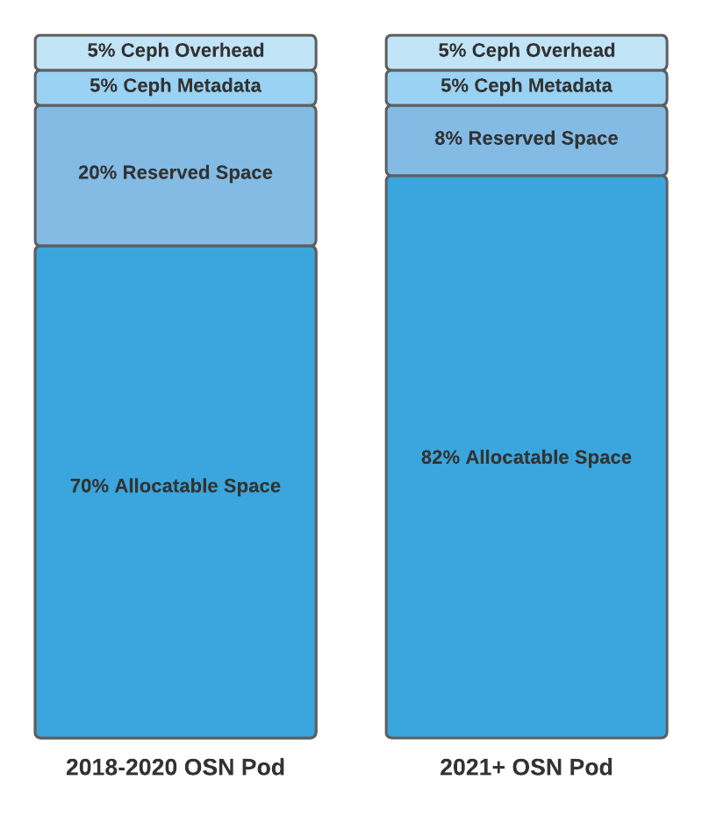
OSN Pod Space Reservations
Ceph Overhead - Disks won’t fill past 95%.
Ceph Metadata - Space reserved for information about objects and accounts.
Reserved Space - Space reserved for node failure. This space is only allocated to projects if the project cannot be allocated on another Pod.
Allocatable Space - Space available to projects.

Slide 19

Future OSN Ceph Updates
Plans to upgrade to Ceph 16.2 (Pacific) in 2021
Switch from ceph-ansible to cephadm for Ceph deployment and management
ceph-ansible too slow to deploy small changes
Prone to failures when disks fail
Will keep using Ansible for managing other software on the pods

Slide 20
OSN Command Center

Slide 21
OSN Command Center
Collection of services hosted on servers at MGHPCC and JHU
Pod provisioning and Software Install/Update
Bootstrap - Bare metal to functioning storage appliance
Software install/updates - Ongoing Ceph and community software distribution
Monitoring and Alerting
Telegraf, Influx, Grafana (TIG) stack, Slack
Web Applications
Storage Portal
Website

Slide 22
OSN Command Center
Collection of services hosted on servers at MGHPCC and JHU
Pod provisioning and Software Install/Update
Bootstrap - Bare metal to functioning storage appliance
Software install/updates - Ongoing Ceph and community software distribution
Monitoring and Alerting
Telegraf, Influx, Grafana (TIG) stack, Slack
Web Applications
Storage Portal
Website

Slide 23
Pod provisioning and Software Install/Update
Bootstrap, software install, lifecycle

Slide 24
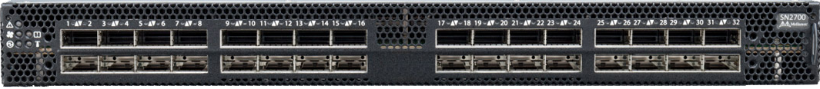

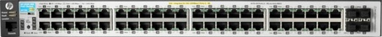
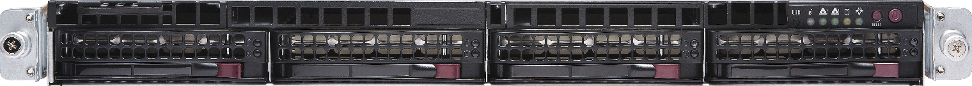
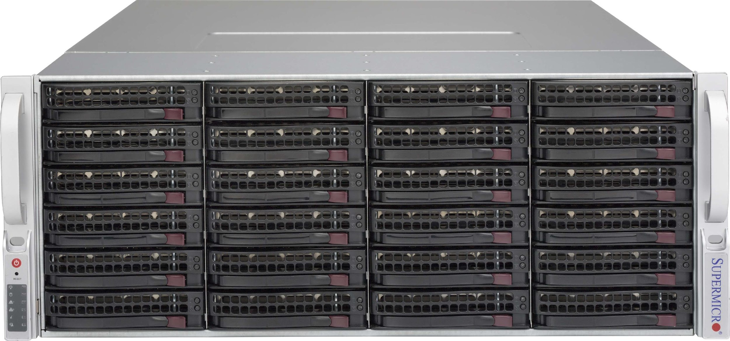

Provisioning - Bootstrap
GitHub
Command Center – OSN Admin
Bootstrap nodes via ansible from command center
Configs pulled from project GitHub repo
Images pushed to gateway node
IPMI / PXE used to bootstrap remaining nodes
mon01
Gateway
mon02
mon03
ssh
Download Latest Config
dat01
IPMI
dat02
Command Center (Provisioning)
ctl01.osn.xsede.org
ctl02.osn.xsede.org
dat03
dat04
dat05

Slide 25
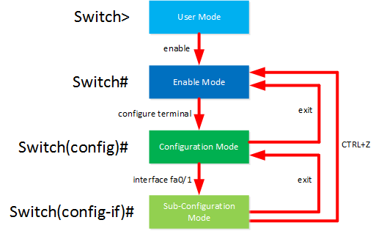


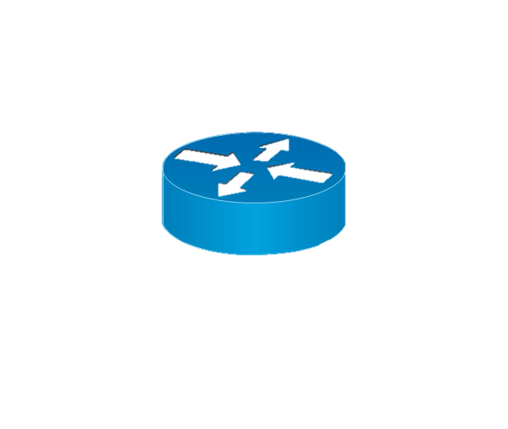


Provisioning - System
GitHub
Command Center – OSN Admin
Bootstrap nodes via ansible from command center
Configs pulled from project GitHub repo
Images pushed to gateway node
IPMI / PXE used to bootstrap remaining nodes
Execute baseline system services installation
mon01
Gateway
mon02
mon03
ssh
SSH/Ansible
Download Latest Config
dat01
Switch configuration
dat02
Package installation
Command Center (Provisioning)
ctl01.osn.xsede.org
ctl02.osn.xsede.org
dat03
routing
OSN Package Repo
https
Firewall/Iptables
dat04
Etc.
dat05
Etc.

Slide 26


Provisioning - Software
GitHub
Command Center – OSN Admin
Bootstrap nodes via ansible from command center
Configs pulled from project GitHub repo
Images pushed to gateway node
IPMI / PXE used to bootstrap remaining nodes
Execute baseline system services installation
Provision Software
storage system (Ceph)
User service stack (Rgw, iRods, etc.)
RGW
mon01
iRods
mon02
Etc.
mon03
ssh
SSH/Ansible
Download Latest Config
dat01
Ceph / Radosgw
dat02
Command Center (Provisioning)
ctl01.osn.xsede.org
ctl02.osn.xsede.org
iRODS
dat03
OSN Package Repo
Etc.
https
dat04
dat05
Etc.

Slide 27


Lifecycle: Software Configuration and Maintenance
Developer checks out a bugfix/feature branch
Modify, debug, and test locally
Trial deployment on a single pod
Implementation team review and and approval
Branch is merged to main branch for deployment in next update
GitHub
Release
Candidate
Release
Command Center
Branch
Release
Validate
Review/merge
Local Test HW/VMs
Test
Develop
Test/Staging
OSN
Sites
Community Development

Slide 28
Monitoring and Alerting

Slide 29
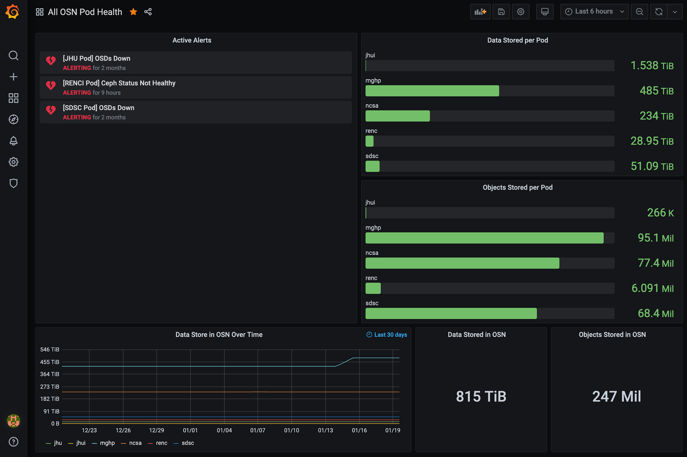
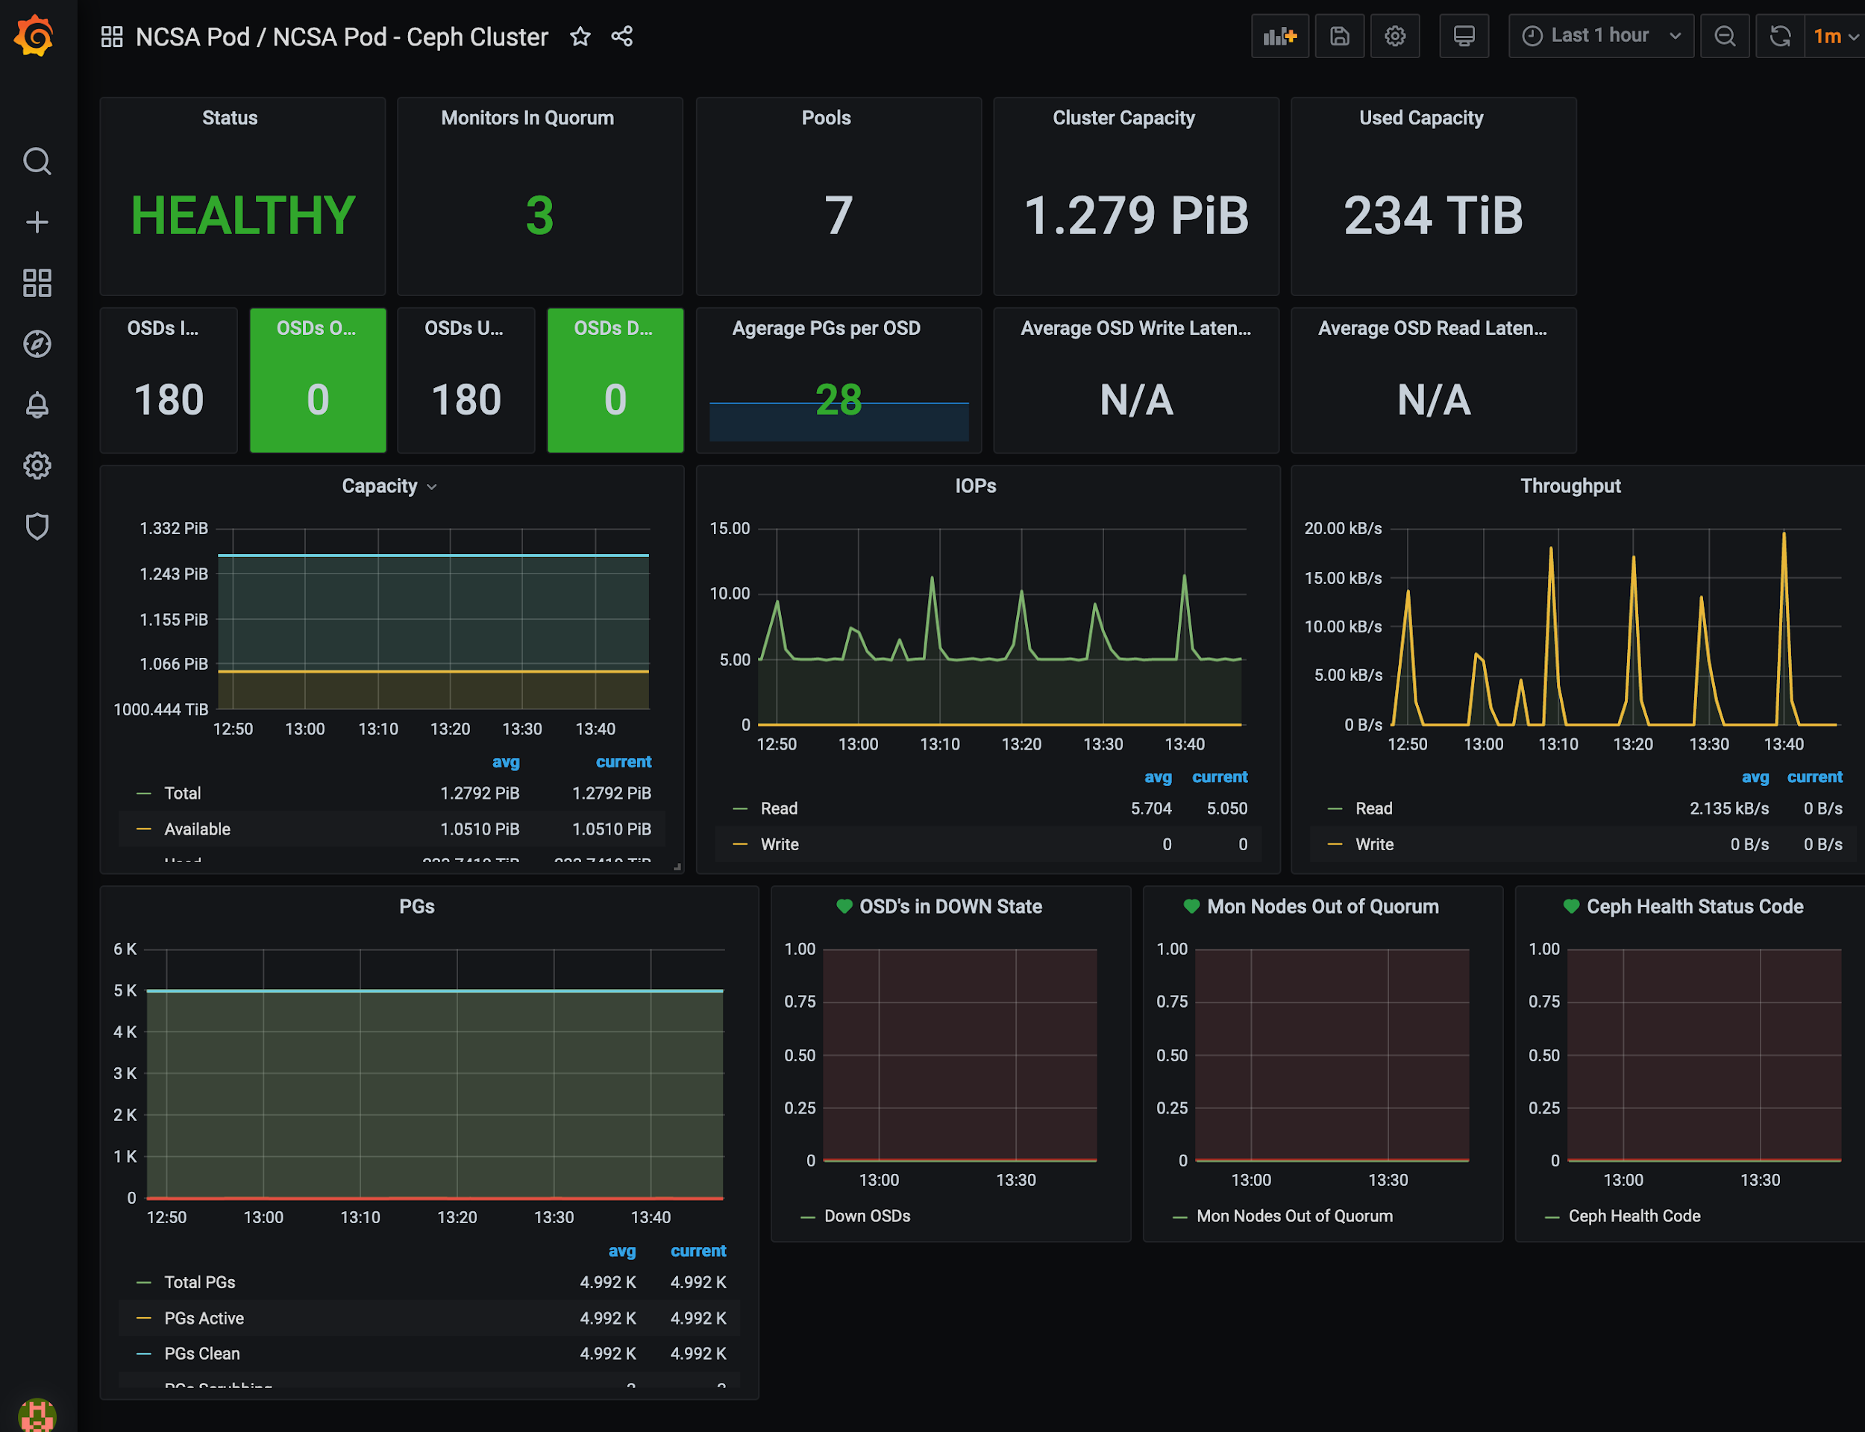
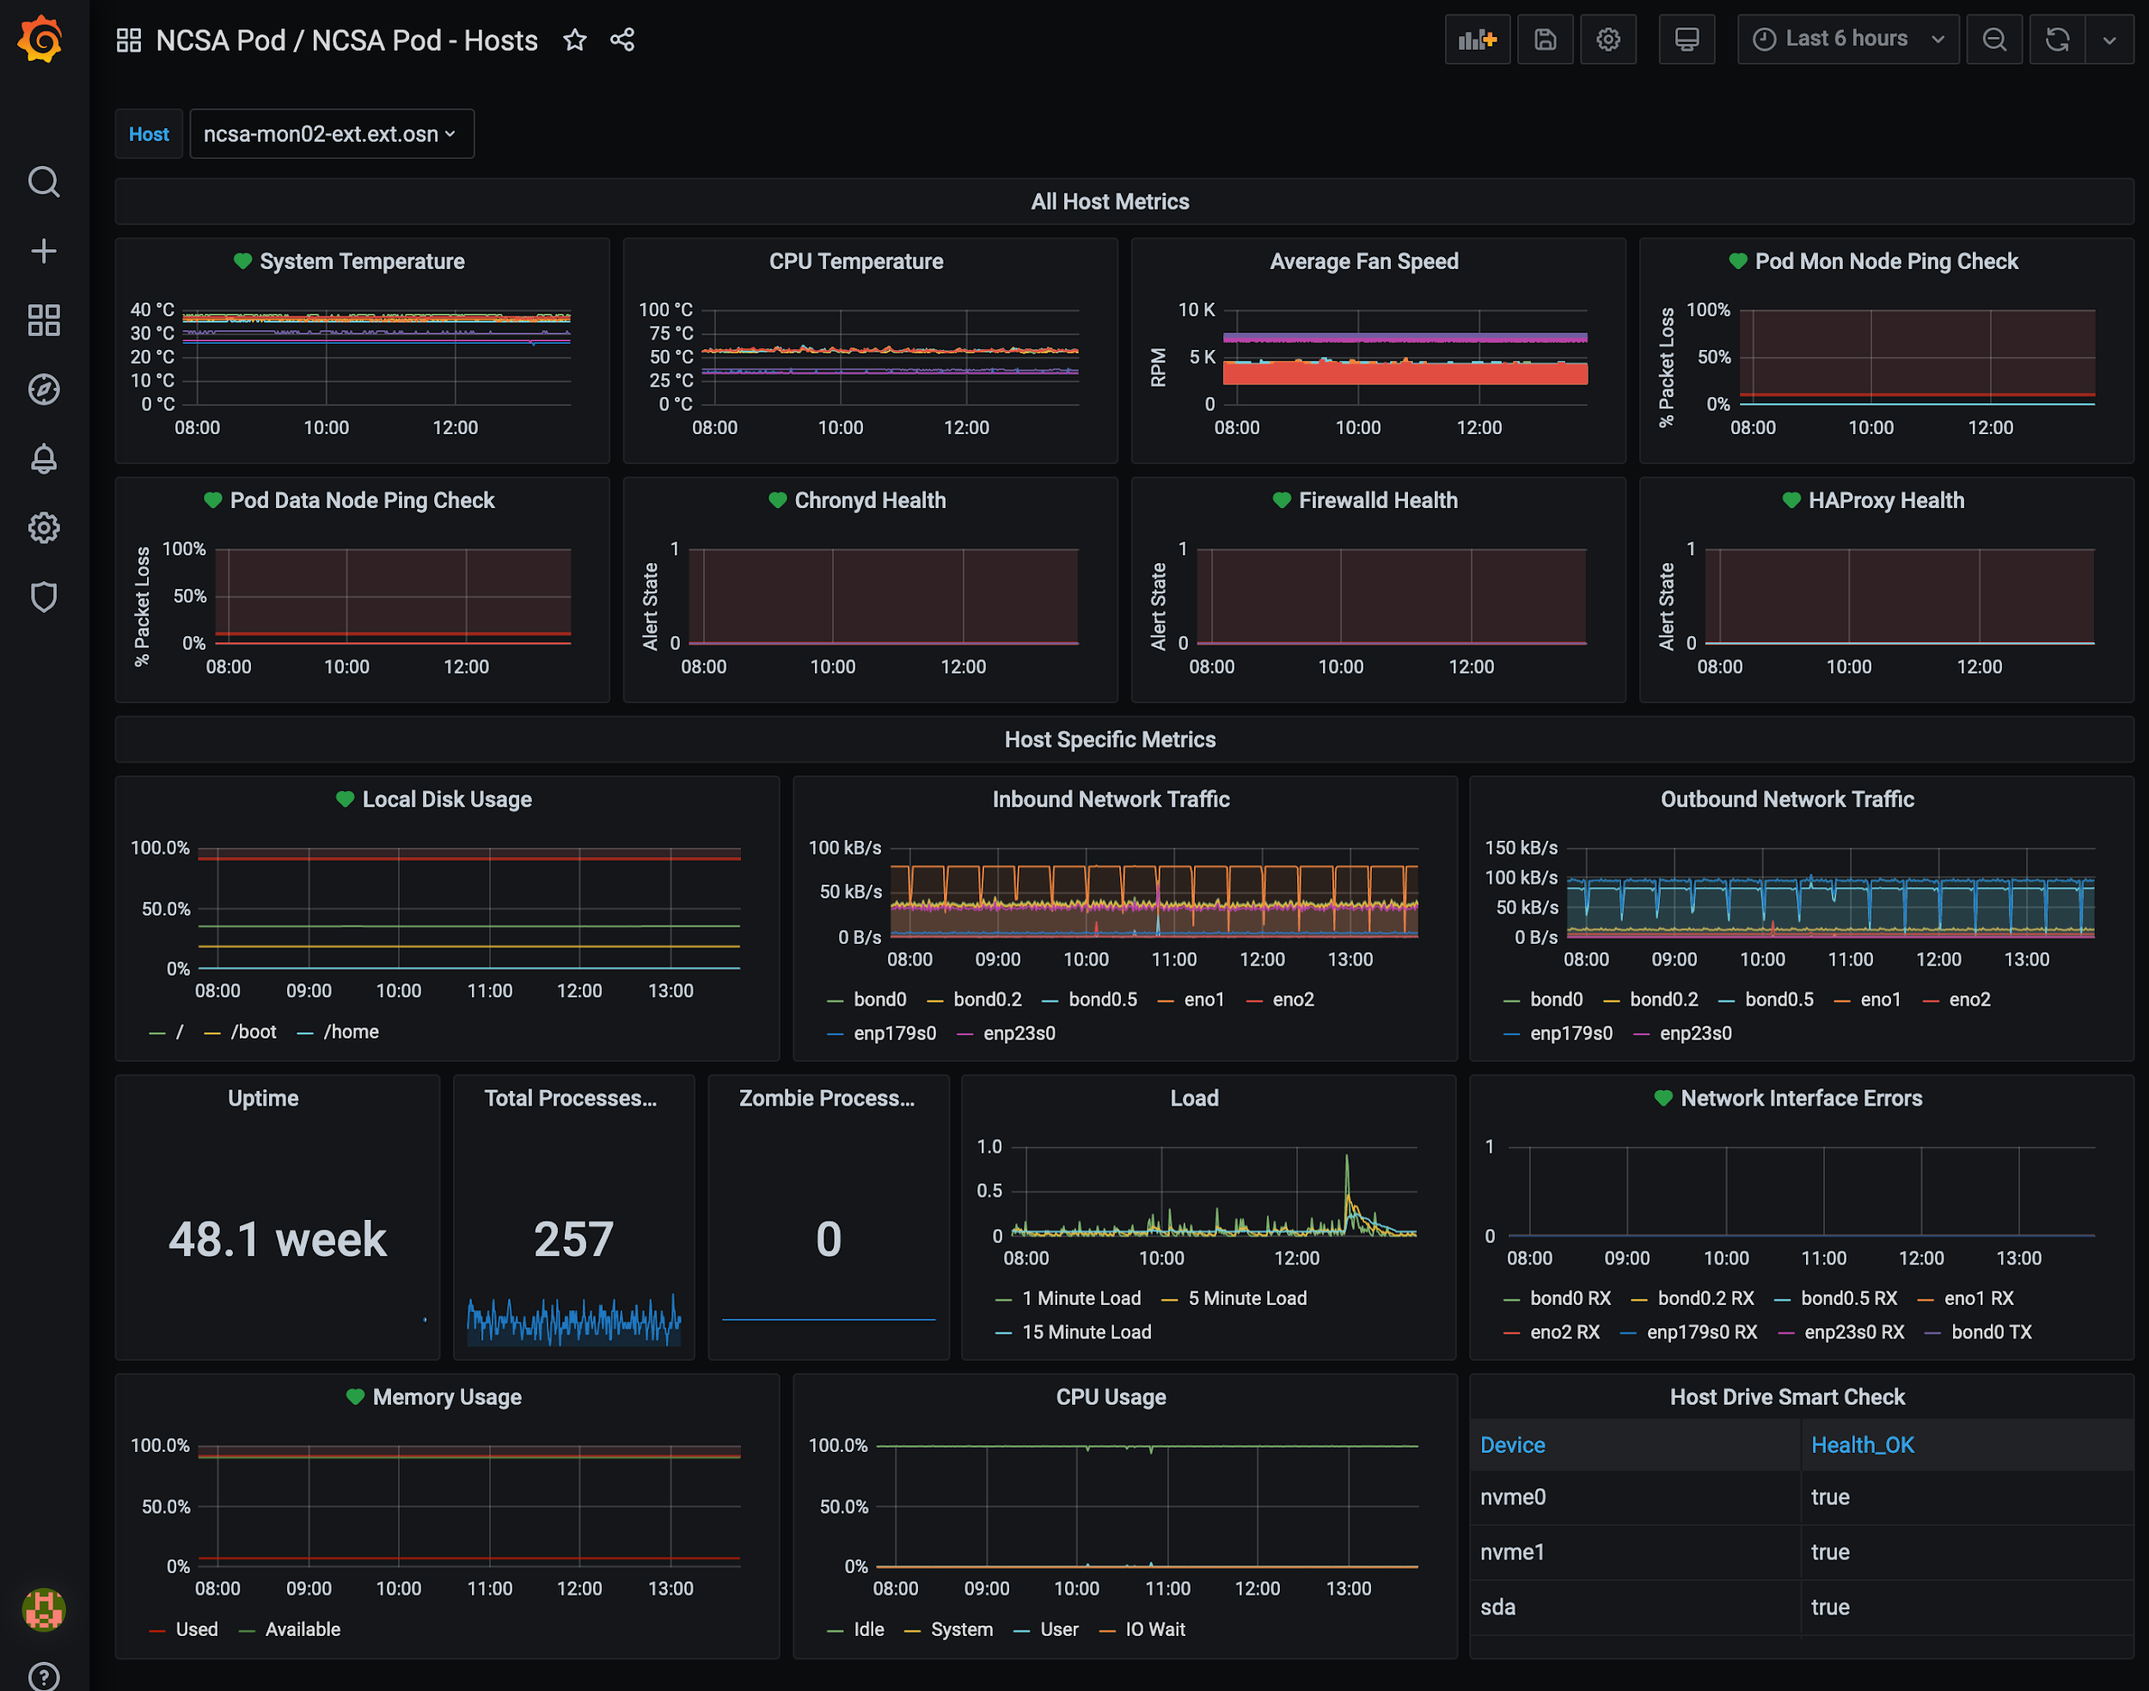
Monitoring - Telegraf, InfluxDb, Grafana
Dashboard
Pod Ceph
Pod Hardware

Slide 30
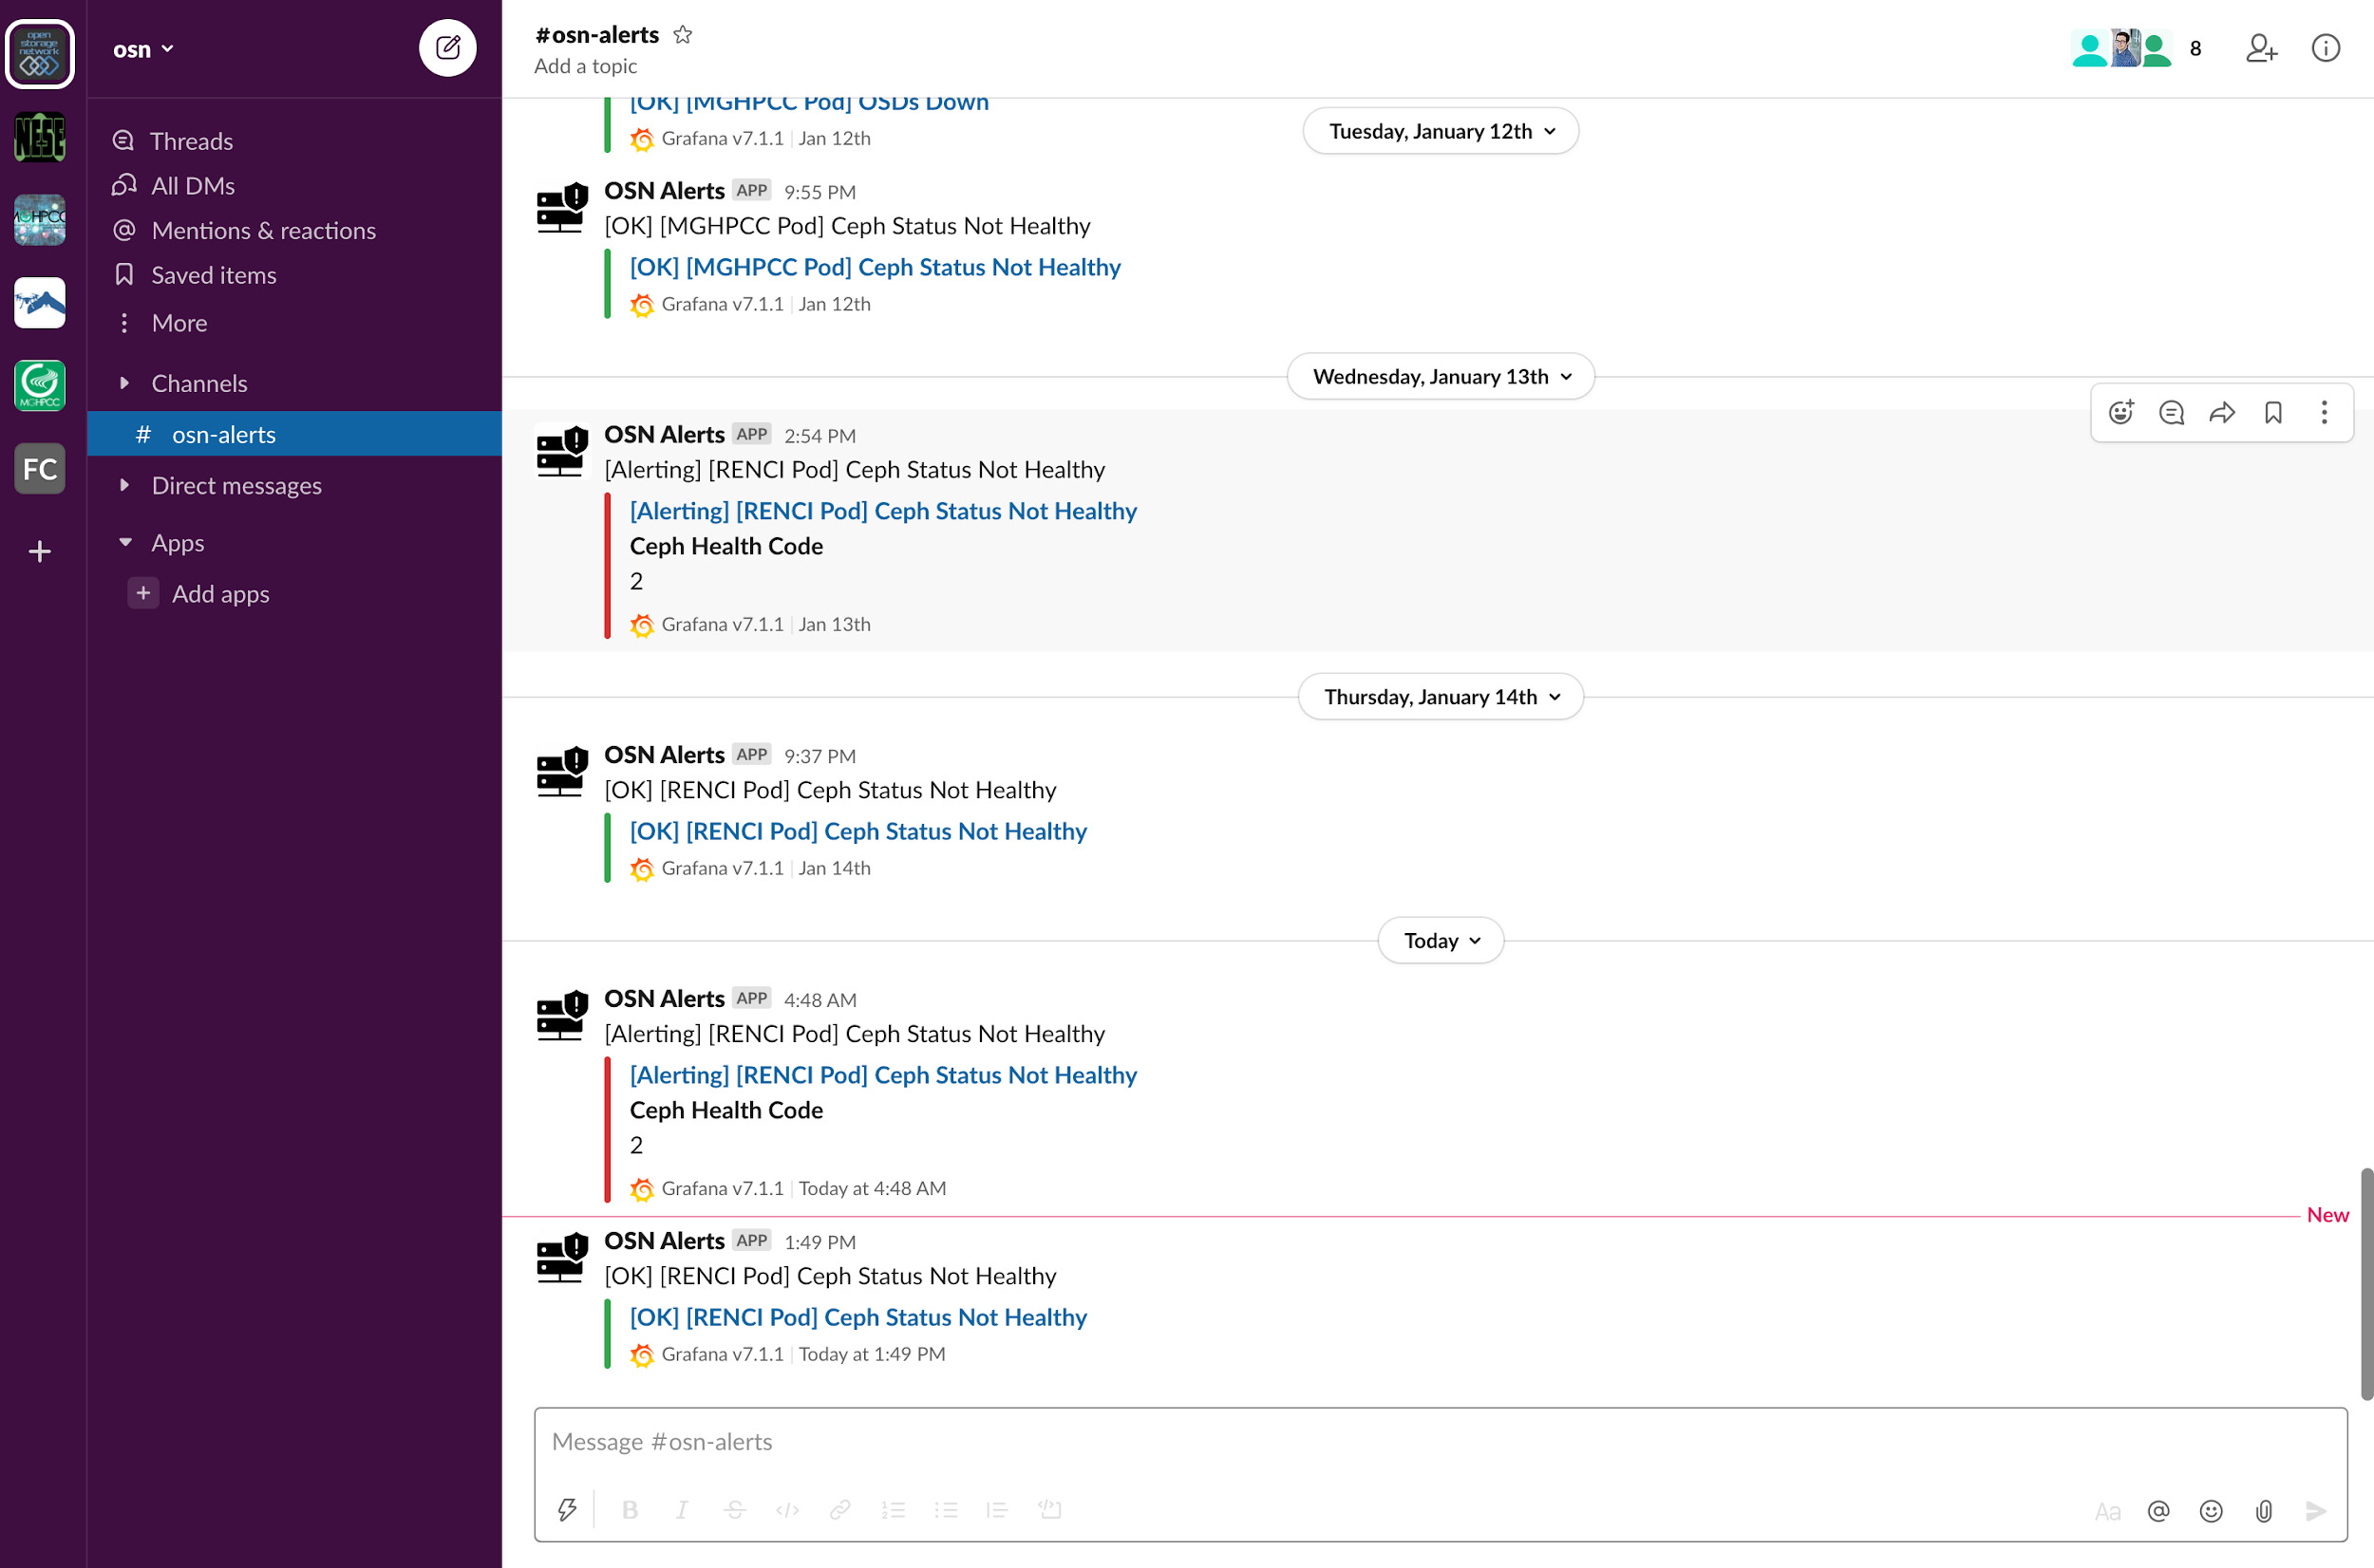
Alerting - Slack

Slide 31
Web Applications
Storage Portal and Website

Slide 32
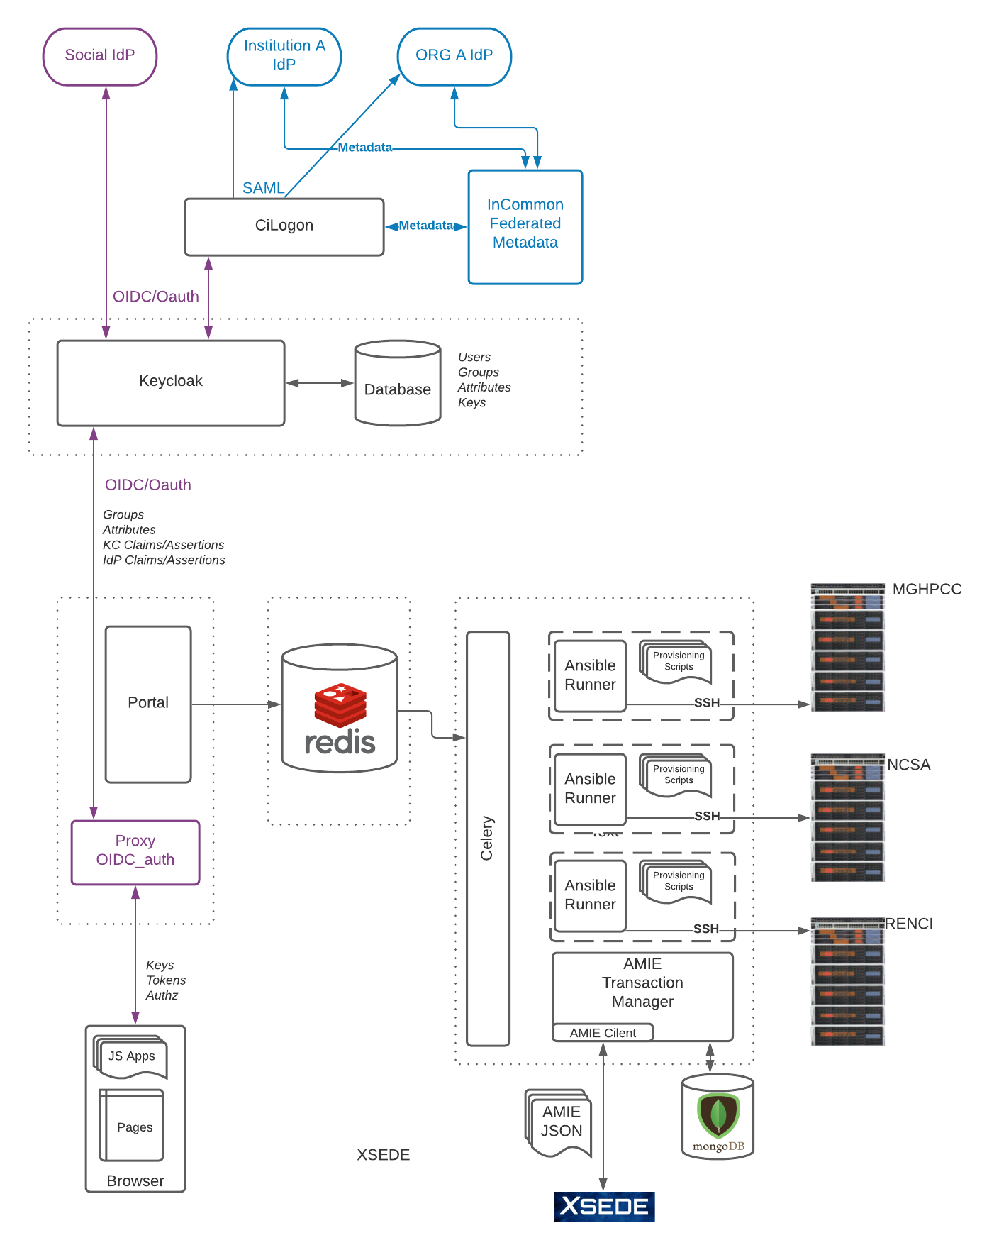
Storage Portal - Architecture
Four User Communities:
End User
Data Manager
Data Curator
OSN Administrator

Slide 33
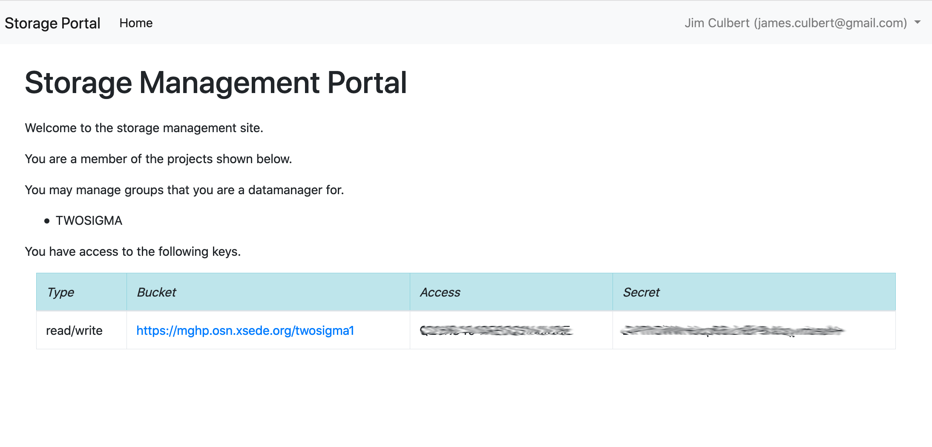
Storage Portal- End User / Key Distribution

Slide 34
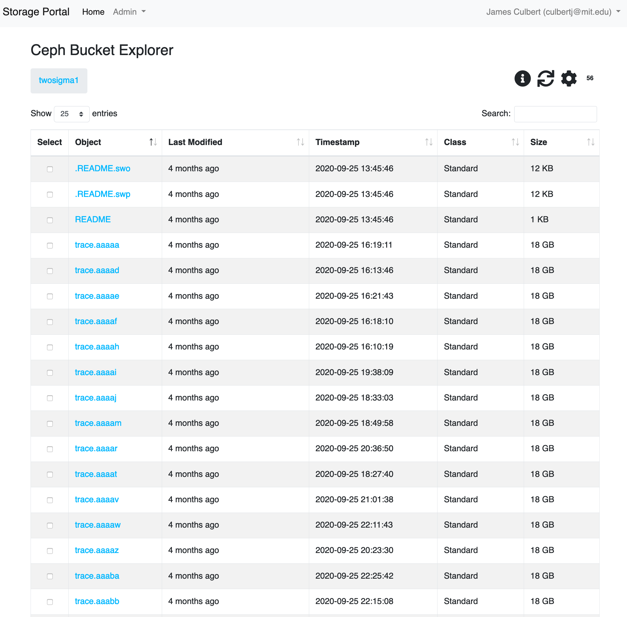
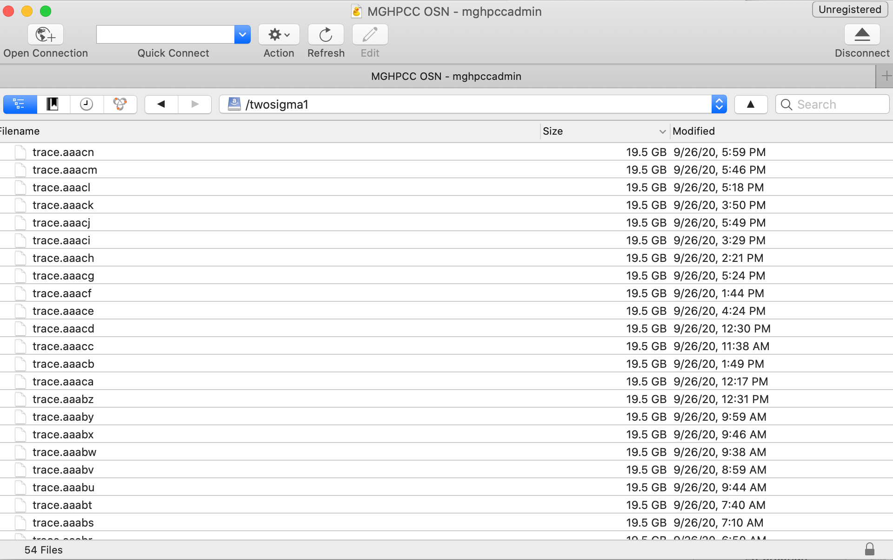
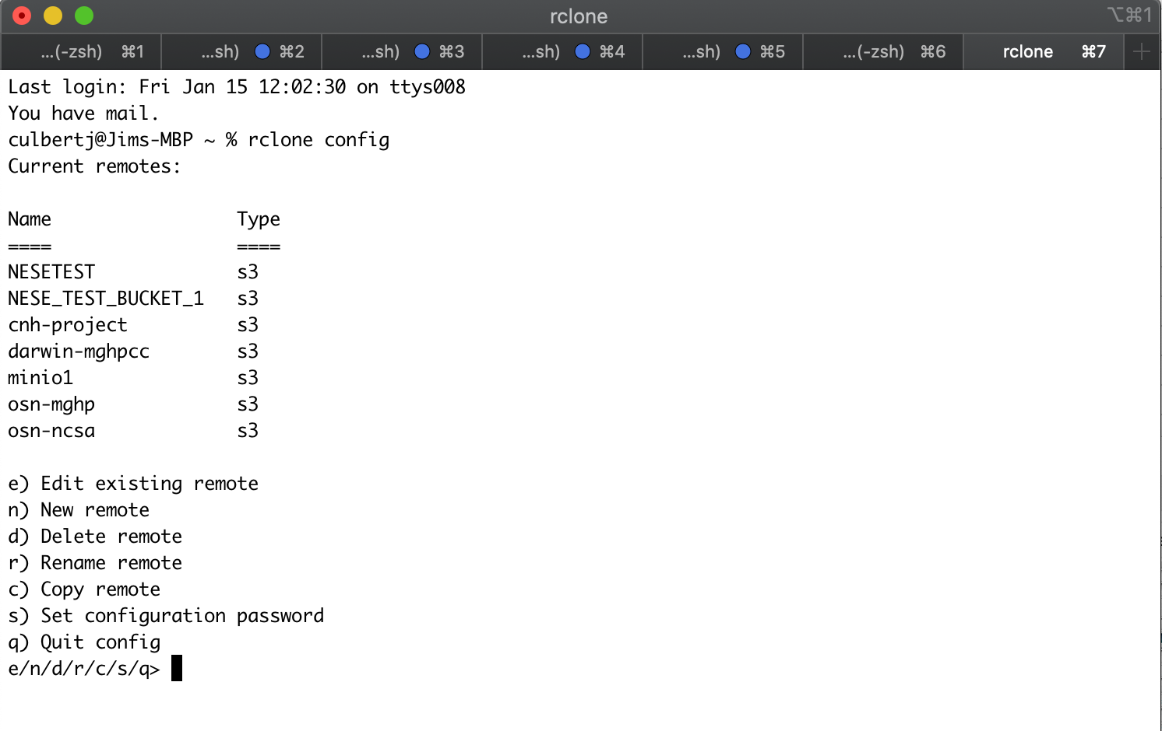
Storage Portal - End User Data Access
Built-in Object Browser
Cloud Storage GUI Client
Cloud Storage Command Line Client

Slide 35
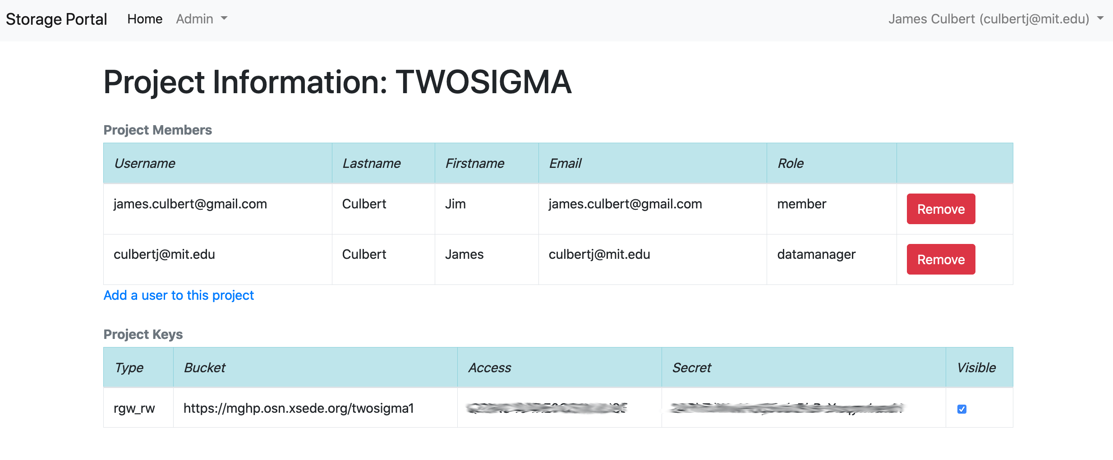
Storage Portal - Datamanager

Slide 36
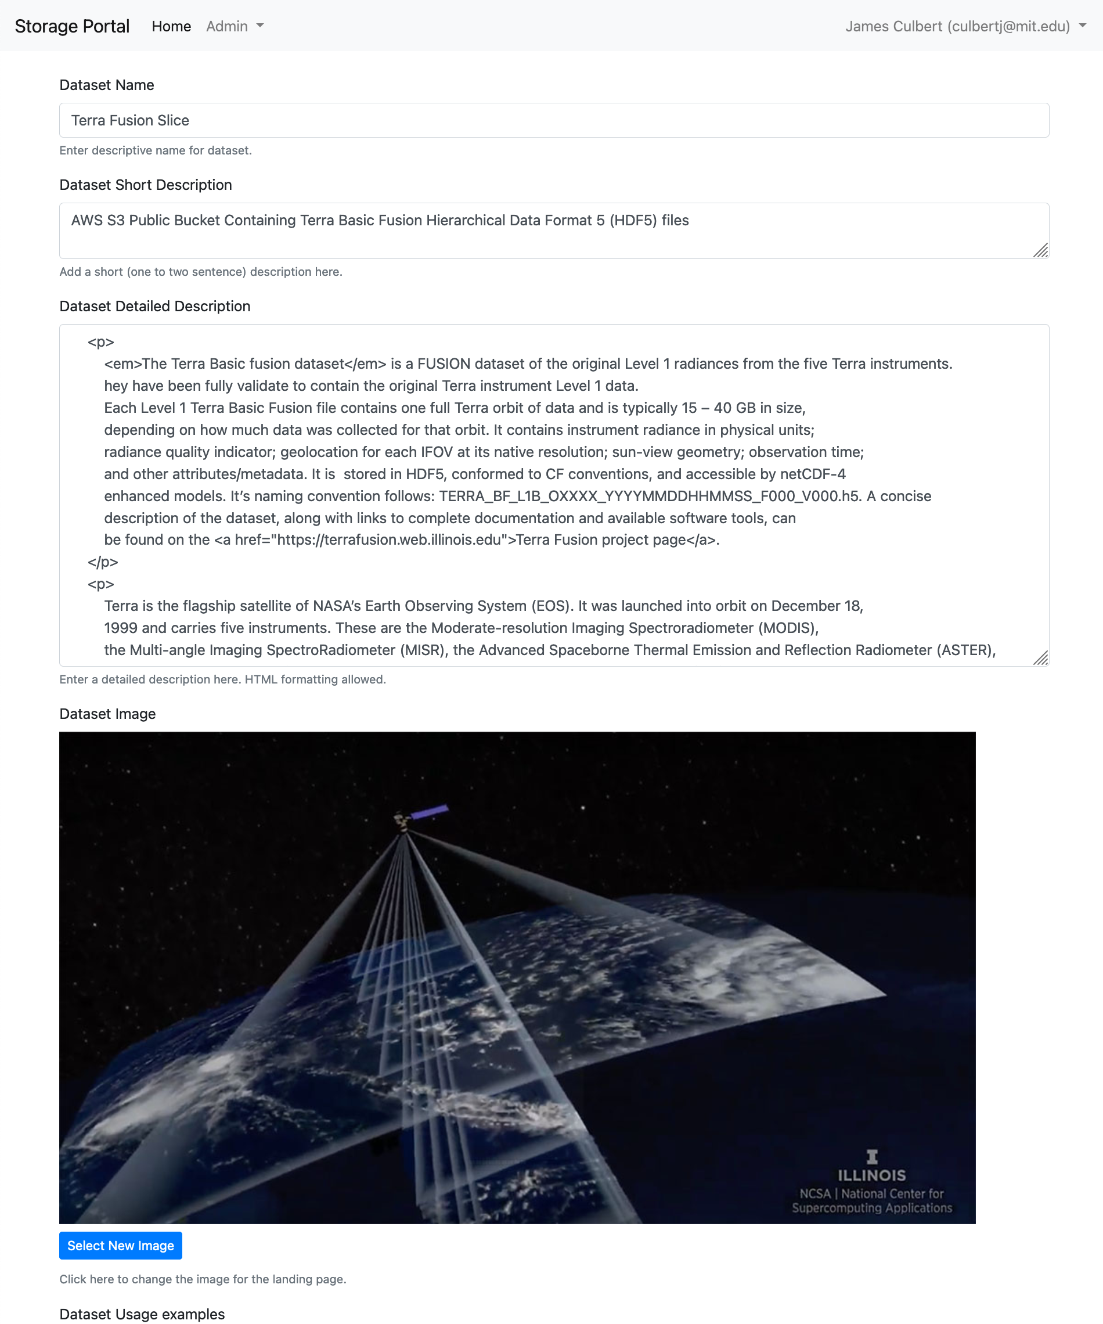
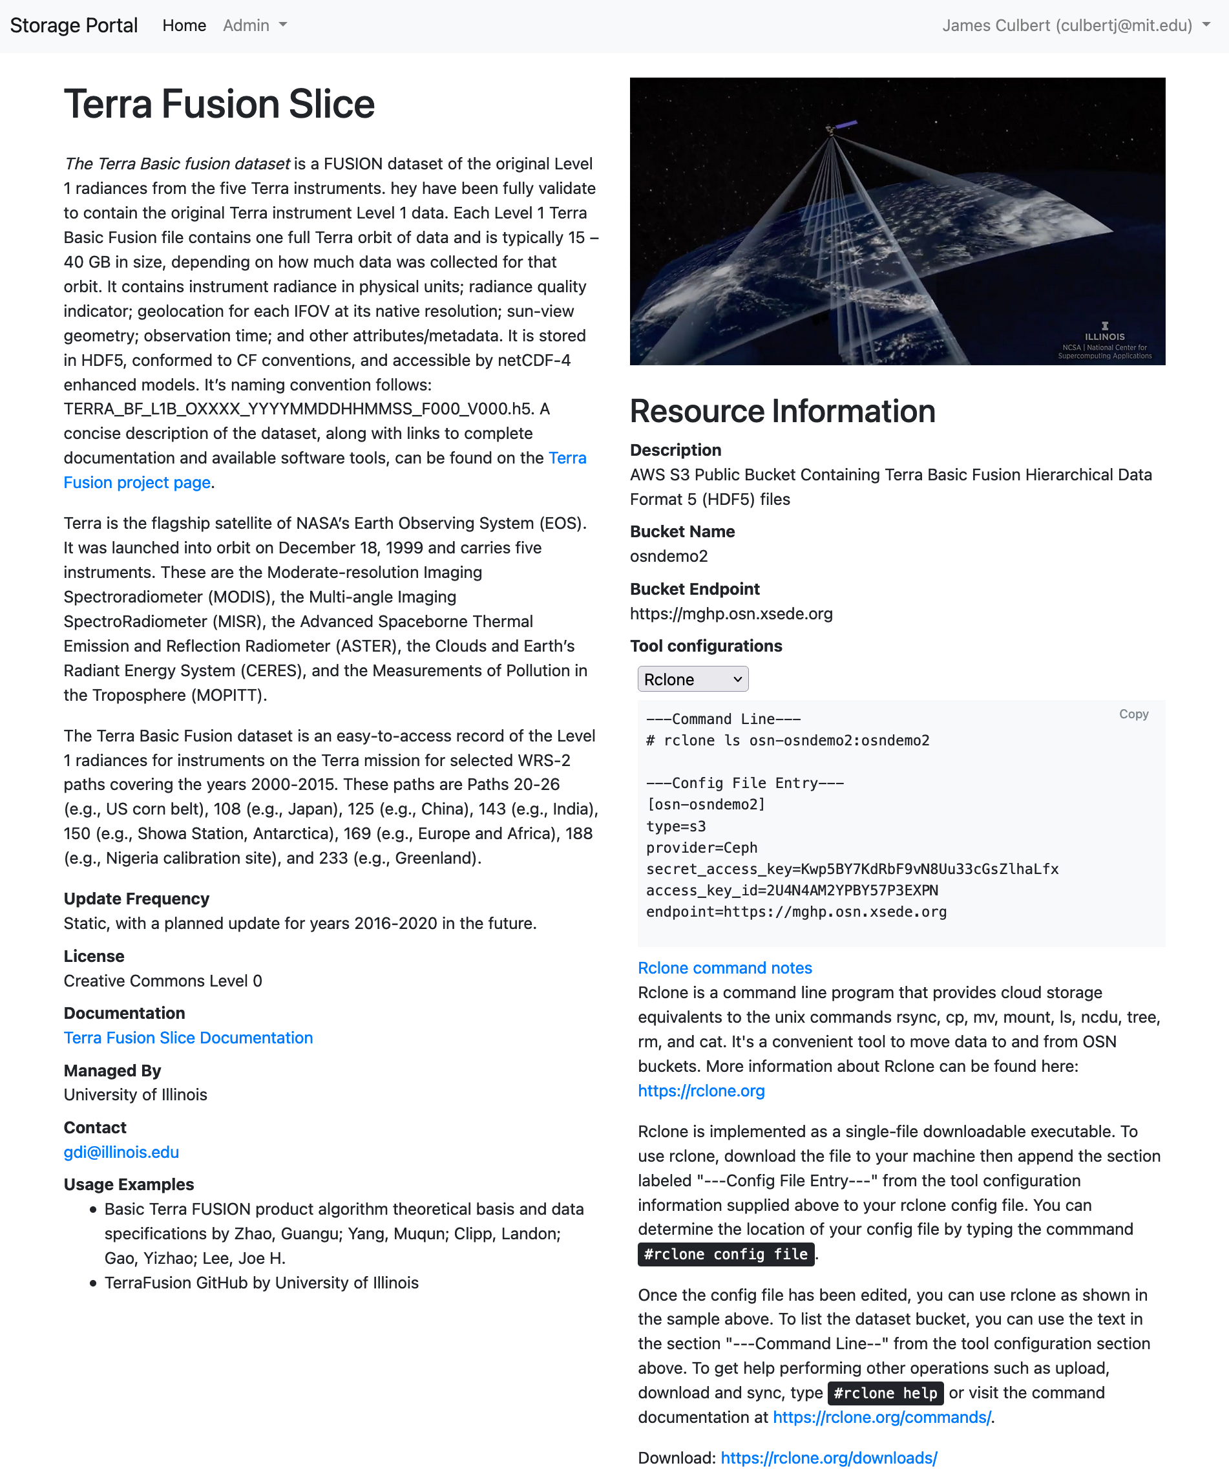
Storage Portal - Data Curator
Landing Page Editor
Landing Page

Slide 37
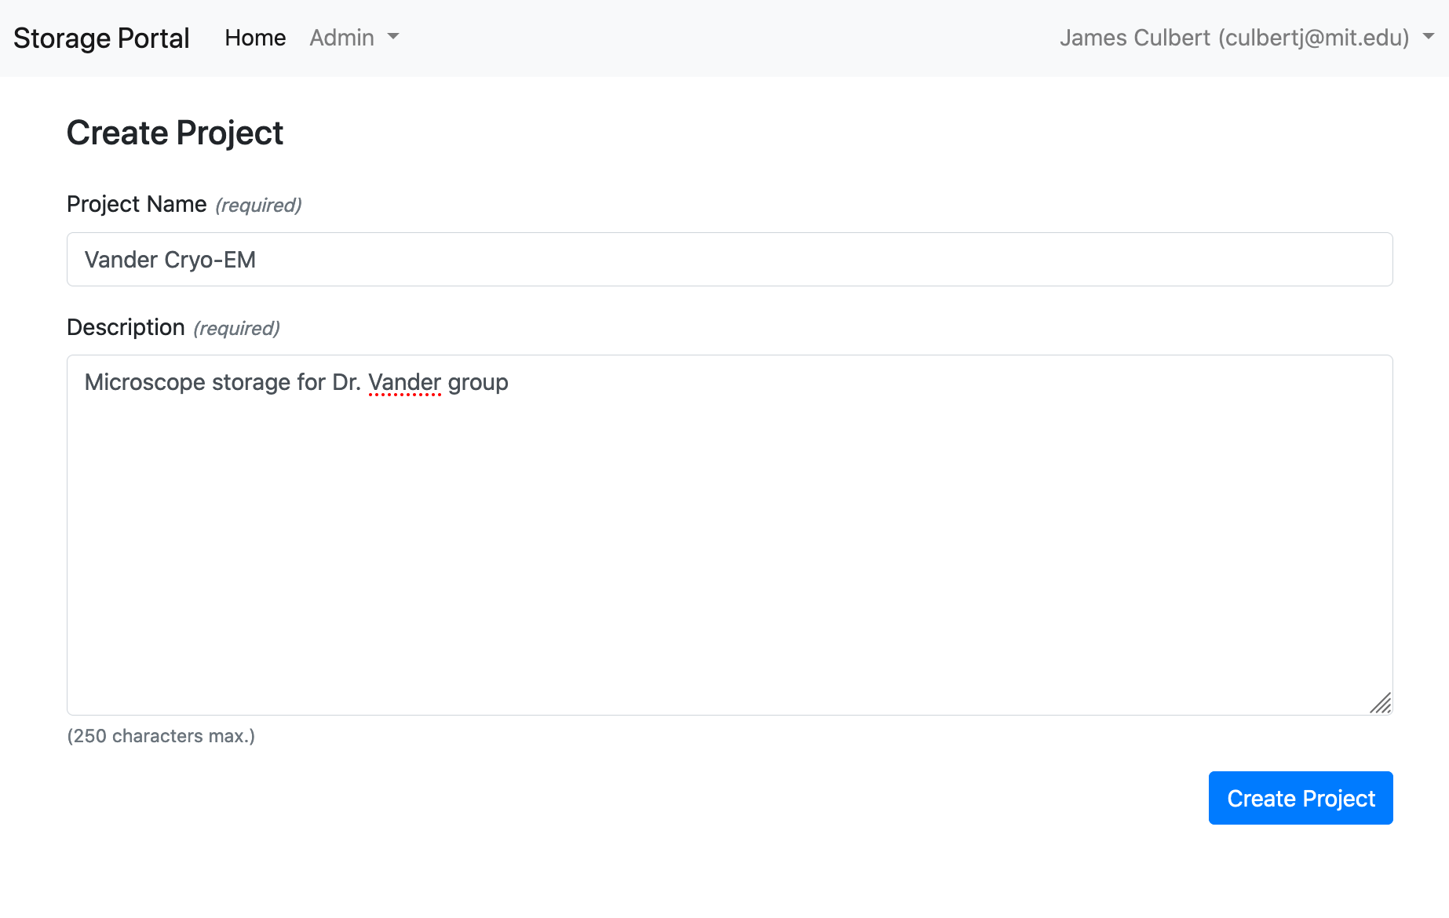
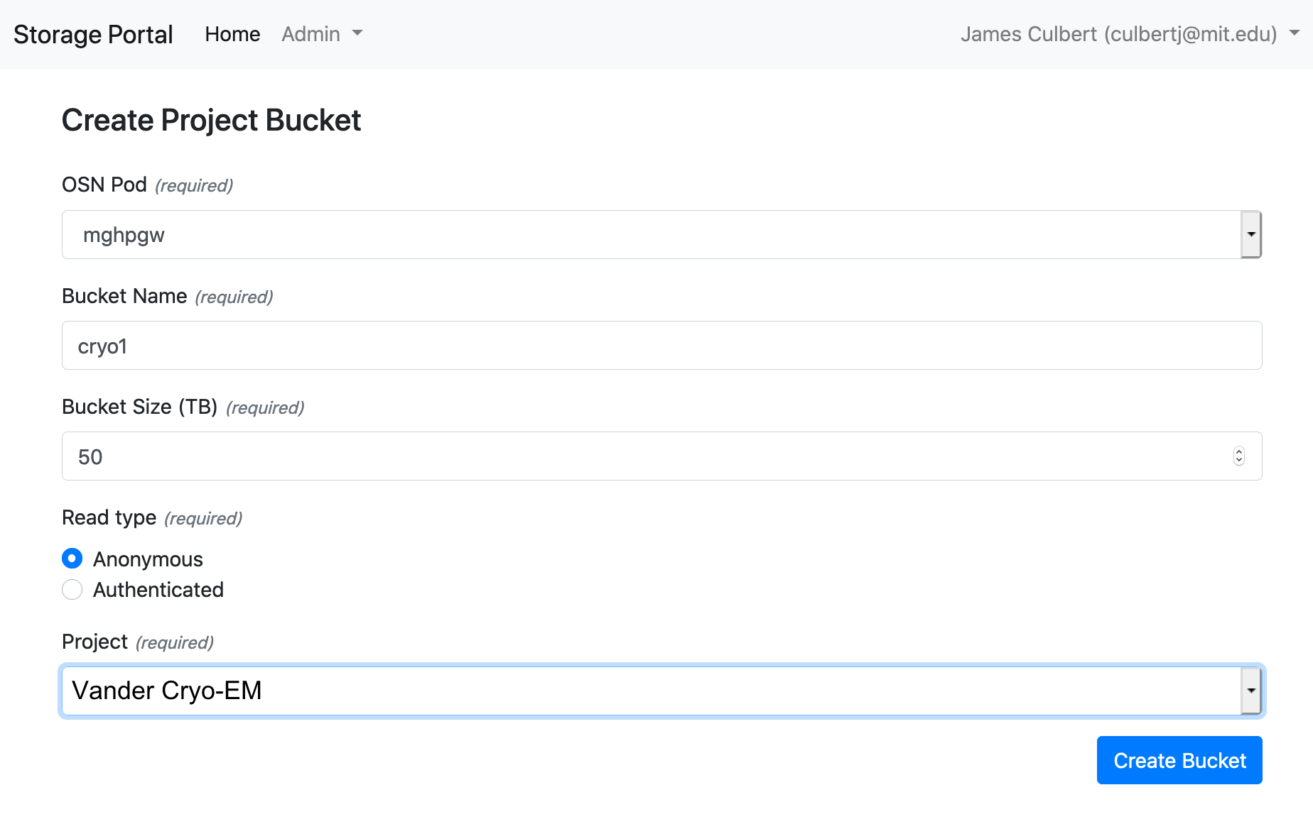
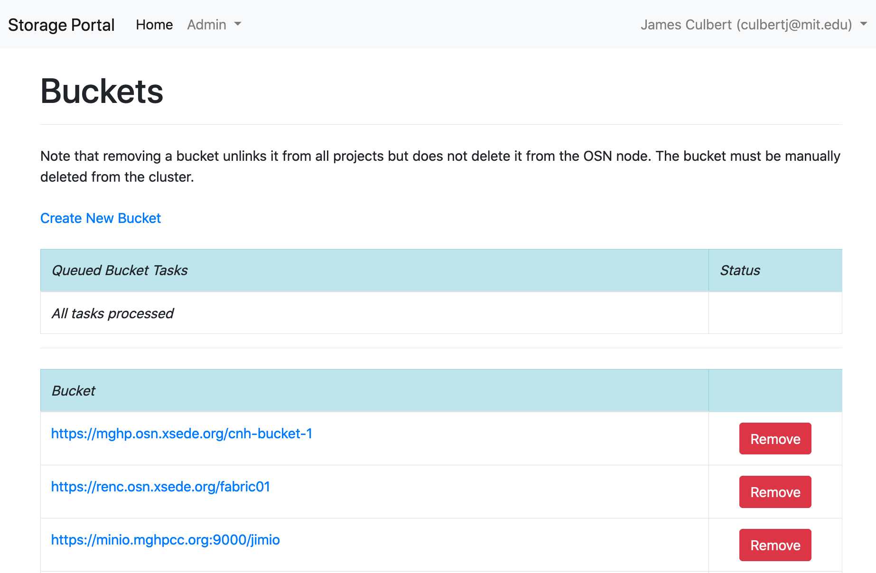
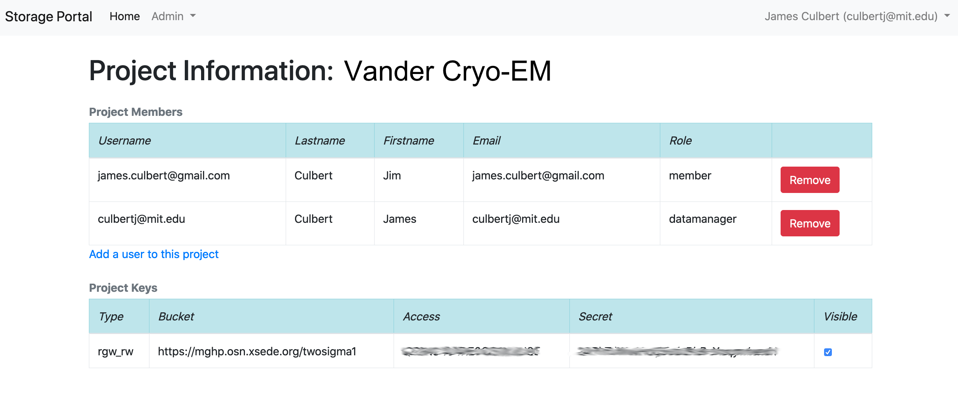
Storage Portal - OSN Administrator (Manual)
Create Projects
Create/Assign buckets to projects
Assign Datamanagers to projects
Manage buckets

Slide 38
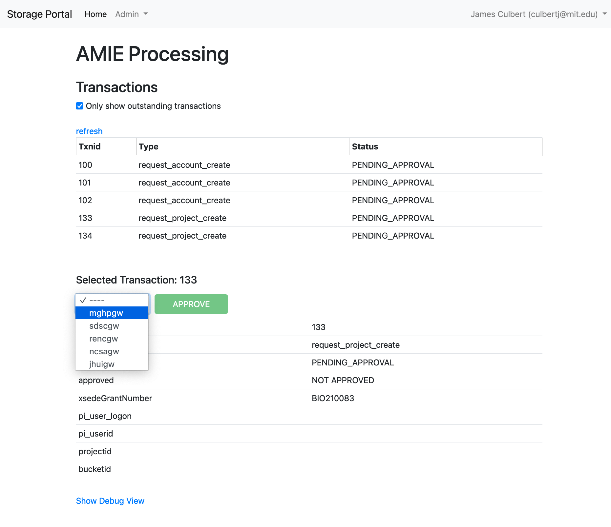
Storage Portal - OSN Administrator (XSEDE)

Slide 39
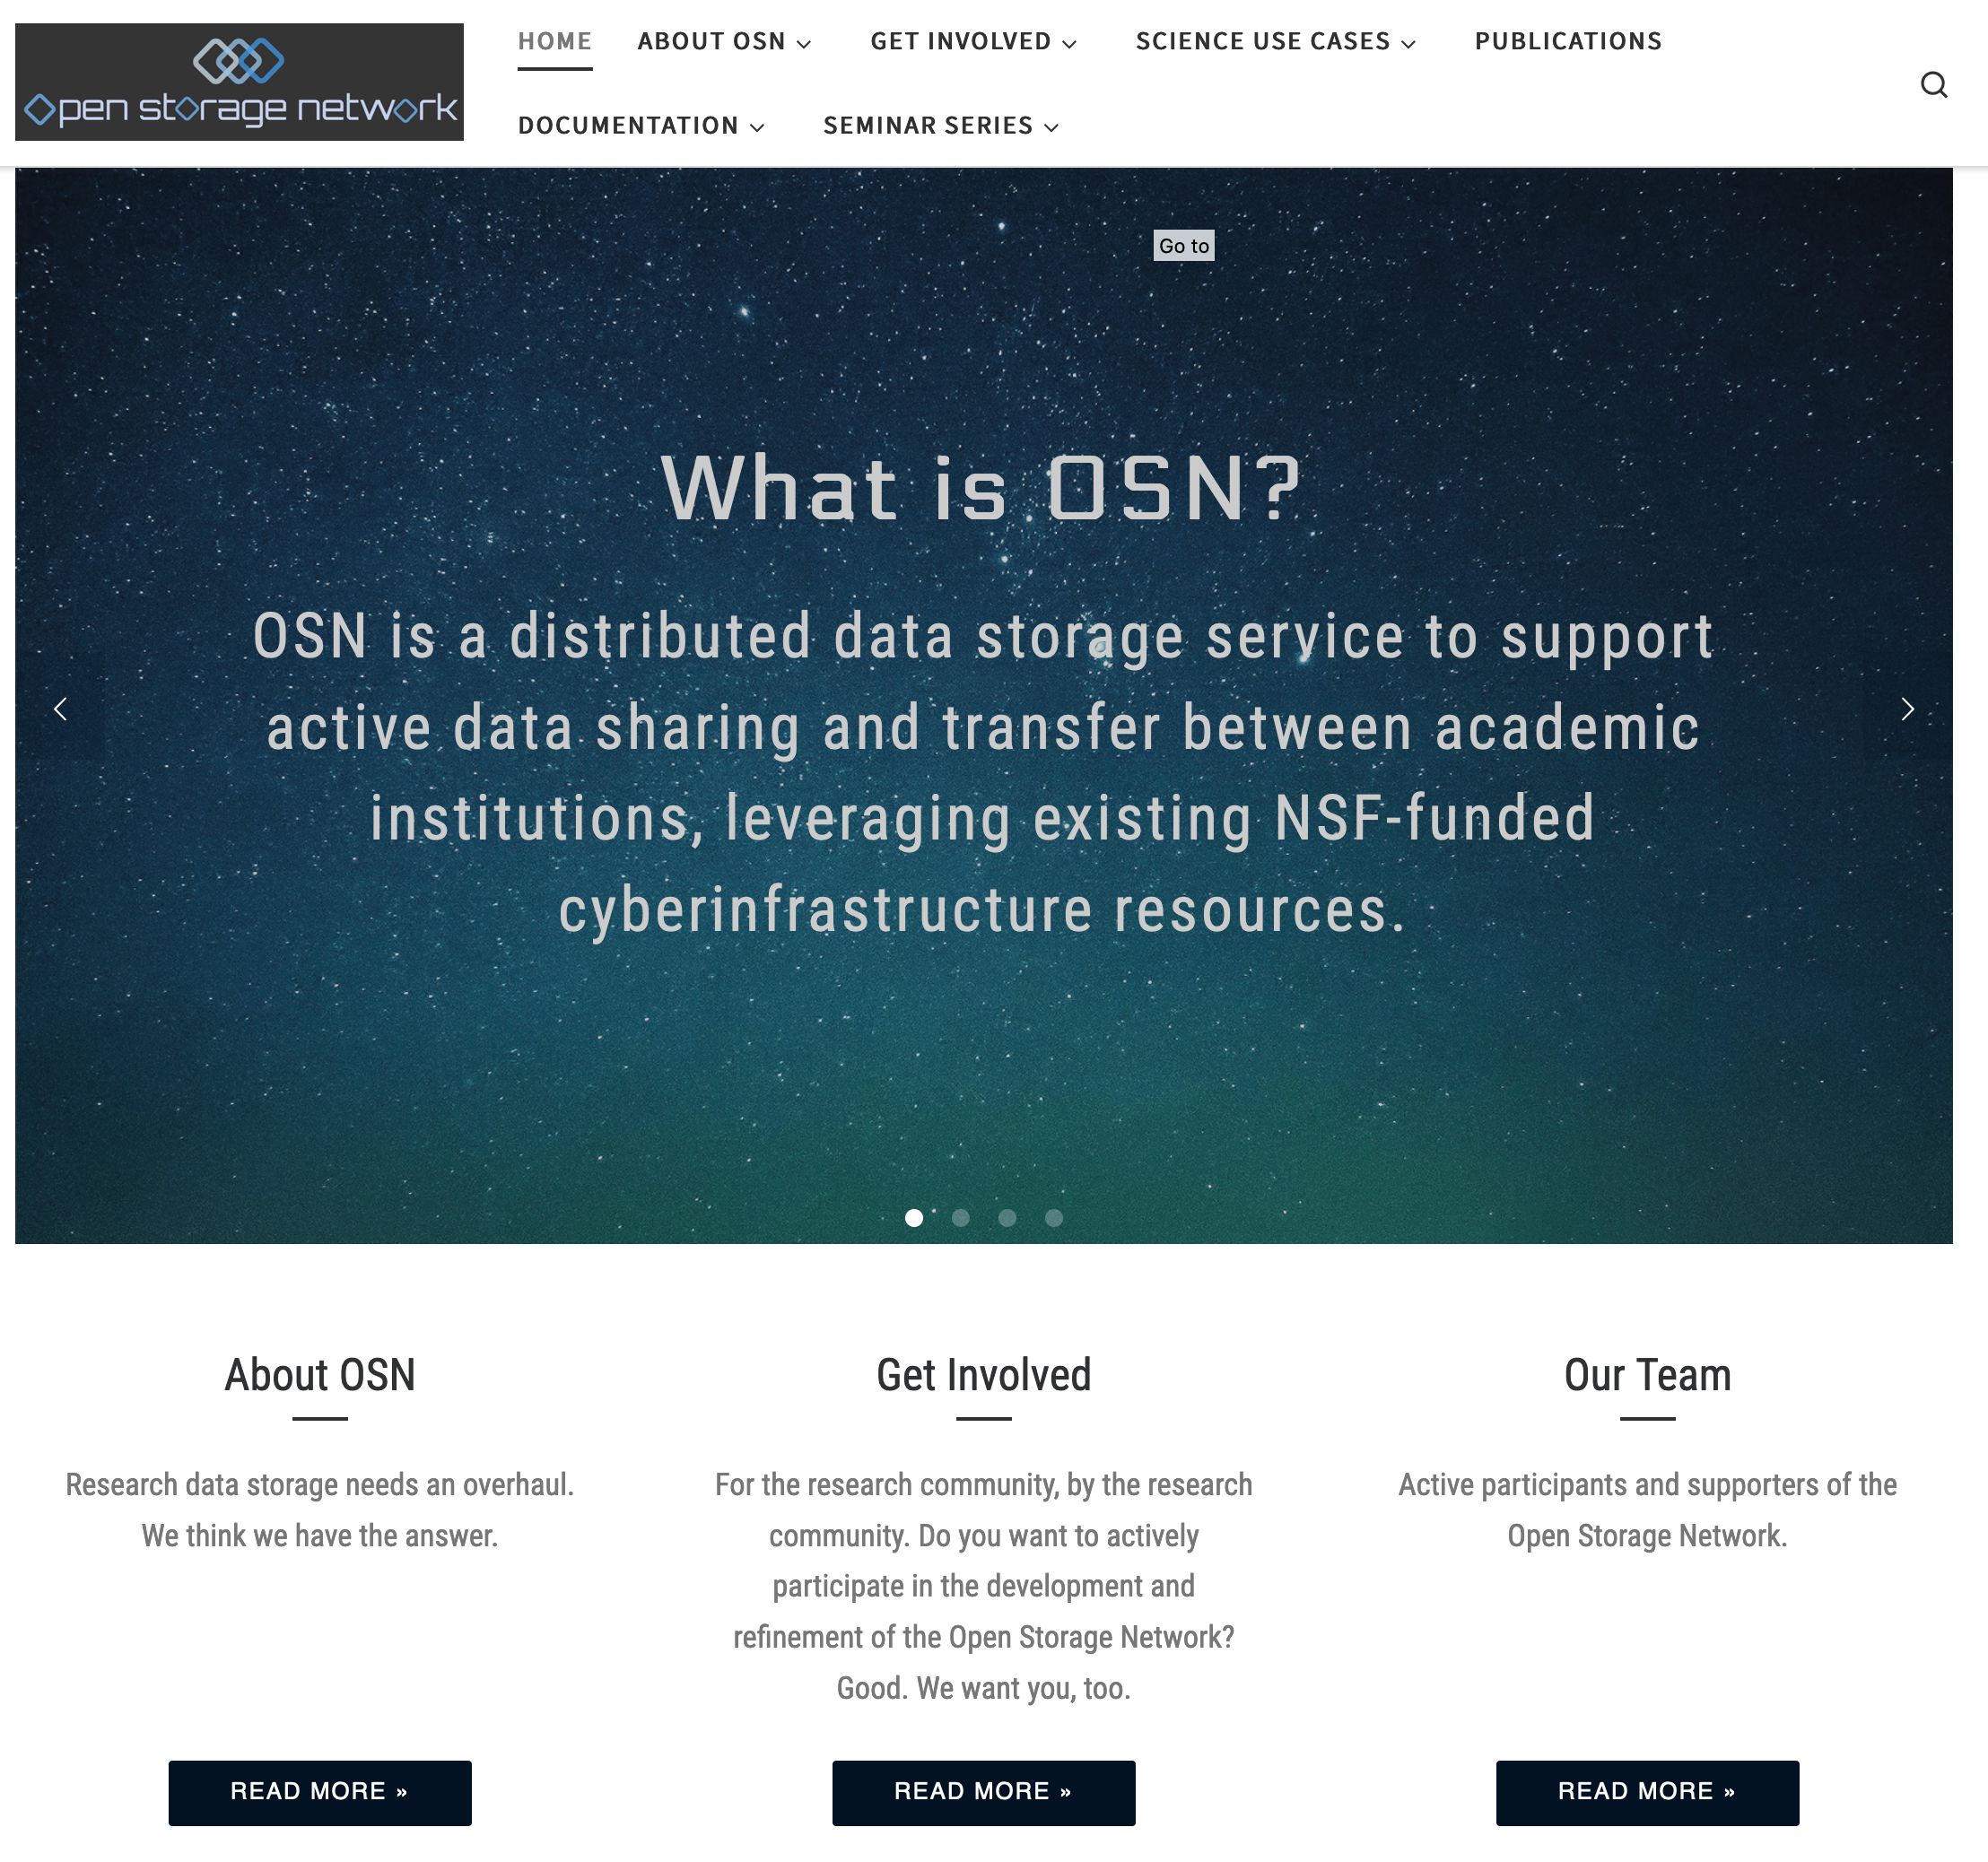
Website

Slide 40
Adding Data Sets | Becoming an OSN Storage Site

Slide 41
A Few Simple Ideas
• Collaborative Governance and Operation
• Geographically distributed Storage, accessible via URIs
Centralized management where needed for cost effective operation

Slide 42
Adding a Data set to the OSN
• Up to ~10 Terabytes • XSEDE startup allocation (applications reviewed when received)
• Up to ~100 Terabytes • XSEDE Research allocation (applications reviewed quarterly)
• More than ~100 Terabytes • Work with OSN to obtain funding for new capacity

Slide 43
Adding Capacity to the OSN
• Host OSN storage • In cooperation with other OSN members
• Participate in governance and/or operation • advisory board | leadership team | devops team

Slide 44
Hosting OSN Storage – General Considerations
• Network Access • Locate pods in a Science DMZ, with access to Internet2
• Security • Sites are responsible for physical access control and network security outside the pod • OSN Pods follow Trusted CI Center of Excellence guidelines
• Software Installation and Maintenance • Supported by the Command Center
• Hardware Acquisition, Installation, and Maintenance • See next slide

Slide 45
Hardware
Acquisition, Installation, and Maintenance
• Option 1 - Install an OSN Pod • Single rack of equipment, fully integrated prior to delivery • Hardware failures detected by the Command Center • Site staff needed for hardware replacement
• Option 2 (in development) - Leverage Existing Storage • Assign a slice of an existing storage system to the OSN • Install an OSN gateway that supports: • Access to the storage via OSN URIs • Management of the storage via the OSN Command Center

Slide 46
Questions
Kevin Coakley
Senior Storage Systems Engineer
SDSC kcoakley@sdsc.edu
Jim Culbert
Director of IT Services
MGHPCC culbertj@mghpcc.org
John Goodhue
Executive Director
MGHPCC jtgoodhue@mghpcc.org

